Slide 1

Welcome to
Big Yellow Mining

Slide 2
Welcome to Big Yellow
We want everyone at Big Yellow
to work with each other and
practice a Healthy and Safe Workplace
which achieves
“Zero Harm”
for everyone

Slide 3
Our Human Rights
We are all entitled to be treated with fairness and respect in a workplace that is free from discrimination and harassment
Unacceptable Behaviours include:
Harassment & Sexual Harassment
Unlawful and Racial Discrimination
Bullying
Victimisation
Unacceptable Behaviours Will Not Be Tolerated

Slide 4
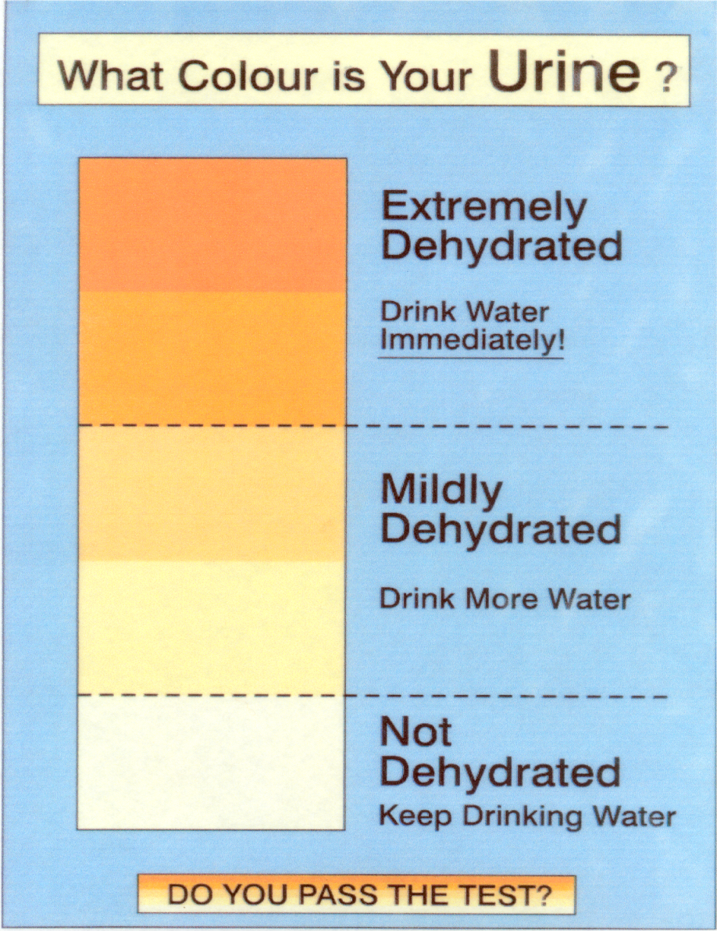
Dehydration
Drink water regularly to
ensure you are well hydrated
How do we monitor our
water intake?

Slide 5
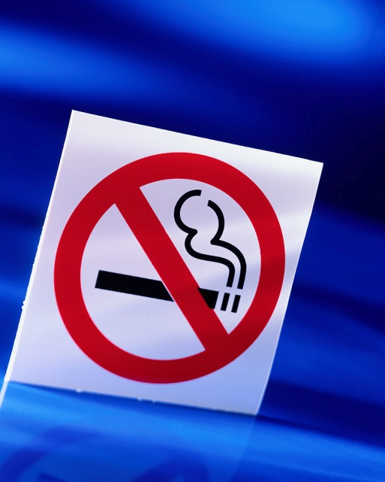
No Smoking
What are some of the areas that you
would consider smoke free?
Notes:
All enclosed workplaces are smoke-free - Offices, Crib rooms, Vehicle cabs, Toilets, Fuel and oil storage areas, Magazines, Chemical storage areas.

Slide 6

Personal Mobiles
Personal and unauthorised mobile phones
are not permitted on site
What are some of the risks associated
with mobile phones on site?
Notes:
Unauthorised mobile phone found on site will be confiscated.
Should anyone NEED to carry a personal mobile phone during work hours, permission must be given by the Project Manager.
Site contact details can be obtained from site administrators so that family and friends can contact us in urgent situations.
Distracted while trying to use phone
Potentially serious news could make you a risk to everyone else on site
Camera’s in phone take inappropriate photo’s
Contacting family at the end of the day will give you something to look forward to apart from dinner

Slide 7

Digital Music Devices
Why can’t we listen to music through ear phones when operating vehicles or equipment?
Notes:
Ear phones may not be used on site as they hinder our ability to clearly hear 2-way communications
Ipods and MP3 players can only be played by using a radio transmitter linked with the equipment am/fm radio
Personal Laptops, Tablets and DVD players are not permitted on site
Any digital music devices being used with ear phones will be confiscated

Slide 8
Jewellery
What jewellery can you wear on site?
Notes:
No rings on fingers
Neck jewellery under clothing
No bracelets or bangles except “Medic Alert” - individuals wearing Medic Alerts should ensure their supervisor is aware of their medical situation
Only watches that have a band with a pin joining link - velcro watch bands are not permitted
Only small ear /facial studs
No loops or hanging earrings

Slide 9
Incidents / Accidents
Yes, we must report all incidents/accidents to your Supervisor
How soon / when??
Notes:
As soon as possible

Slide 10
Safe Operating Procedures
What is a SOP??
Why must you know what is in the SOP associated with the tasks you do?
Notes:
Standard Operating Procedures
SOP’s give guidelines for doing a task.
We must review and understand an SOP before commencing a job.
If an SOP doesn’t exist for a job, then a JSA must be done.
It is important to know the guidelines that will help the task be done safely and effectively

Slide 11
Job Safety Analysis (JSA)
What is a JSA??
Notes:
JSA’s are done when an SOP doesn’t exist for a task or when a job is different from normal operations
A Job Safety Analysis is used to identify the level of risk from a hazard and what controls can be put in place to reduce risk.
This involves breaking the job down into steps, determining what could be a problem or what could go wrong.

Slide 12
Safety Reps & Toolbox Meetings
Why do we have Safety Reps?
Why do we have a safety meeting every month
Notes:
Safety Rep represent the crew on issues of safety and has certain powers as given by the Department of Mines & Petroleum
Each crew elects a Safety Representative
Everyone must attend a Safety Meeting every month
Safety Meetings cover - Incidents and accidents over the past month, Monthly Safety Topics, Safety statistics including MTI’s & LTI’s, Hazards in the workplace, Safety issues each person may wish to raise

Slide 13



















Safety Signs – Obey at all times
Blue & White signs are?
Black, Red & White signs are?
Yellow and Black signs are?
Green Signs are?
Red signs represent?
Hazchem - (diamond shape, differing colours) - dangerous goods
Notes:
Mandatory – (blue & white) - What does Mandatory mean??
Prohibitory & Danger - (black, red & white)
Warning - (yellow / black)
Emergency - Green
Fire - Red
Hazchem - (diamond shape, differing colours) - dangerous goods

Slide 14
Duty of Care for Employees
As employees, we must take care to
Ensure our own safety and health at work
Avoid affecting the safety and health of anyone else
Follow instructions from the employer – if you don’t understand, then ask!
Use PPE and safety equipment in the correct manner as instructed
Not misuse / damage any equipment provided
“Employers and employees working together
will help reduce the risks in the workplace.”

Slide 15
Duty of Care for Employers
Big Yellow Mining must:
Provide and maintain work areas, plant, equipment and systems of work so that employees are not exposed to hazards
Provide information, instruction, training and supervision to all employees
Consult and co-operate with health and safety representatives
Provide personal protective equipment
Ensure that employees are not exposed to hazards in the management of plant and substances

Slide 16
Manual Handling
What shouldn’t you do when doing
manual handling tasks?
Notes:
Lift loads heavier than you are comfortable with – use a mechanical aid if it is too heavy
Hold loads away from your body
Handle a load above shoulder height
Bend forward and handle a load below mid-thigh height
Twisting
Sideways bending and load handling with one hand
Long carrying distances
Strenuous pushing and pulling
Sudden jerky movements.

Slide 17
Safety Data Sheets
All chemicals on site have a Safety Data Sheet (SDS)
Before using chemicals, read the SDS, understand the safety requirements, correct PPE, first aid treatment and storage
Why must you read the SDS before using chemicals?
Notes:
It is hard to read the first aid requirements if you have the chemical in your eyes.

Slide 18
Electrical Testing & Tagging
Electrical items are inspected and tagged quarterly by an authorised electrician
Before using an electrical item, check it’s in good condition and the tag is current
If you find a tag out of date, what should you do?
Red | Green | Blue | Yellow
Dec | Mar | Jun | Sept
Jan | Apr | Jul | Oct
Feb | May | Aug | Nov
Notes:
To remember the colours of tags think “RuGBY”
If you find a tag out of date - attach an ‘Out of Service’ tag to the item and report it to your supervisor

Slide 19
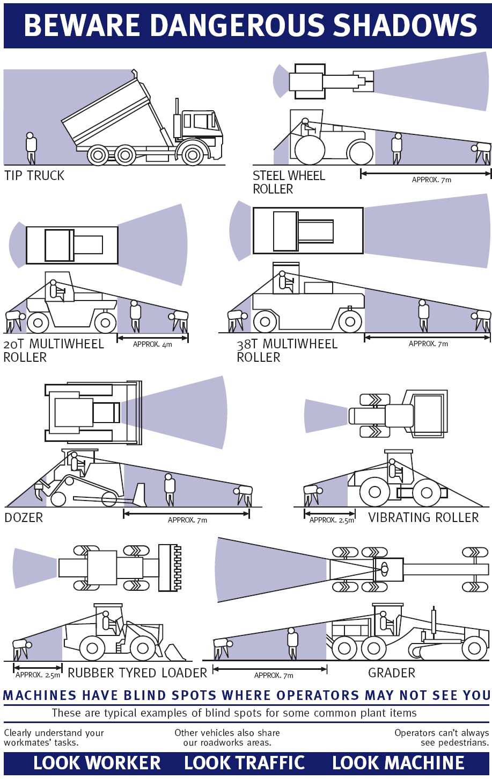
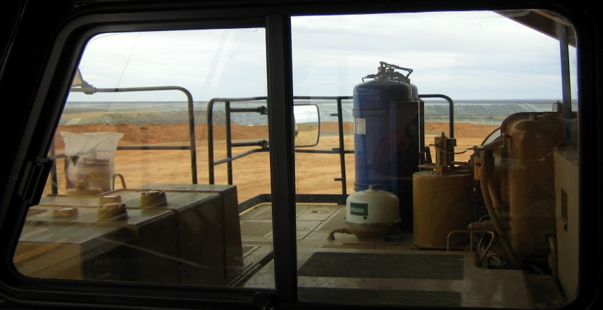
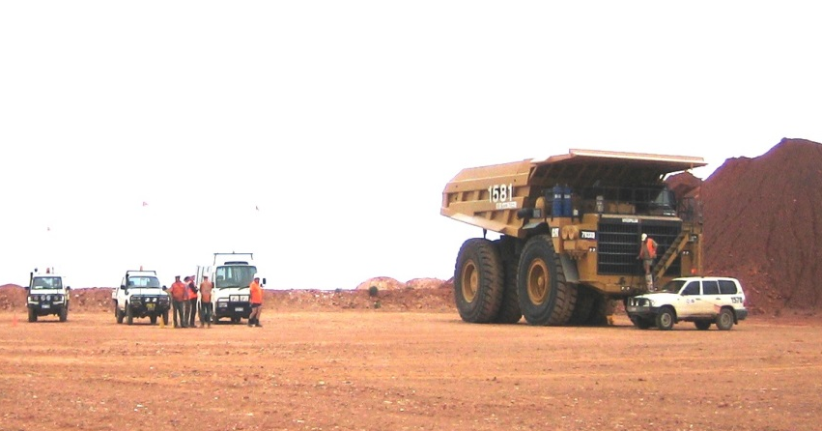
Beware of Blind Spots
Notes:
All equipment has blind spots of some variety.
Be sure that the operator can see you.

Slide 20
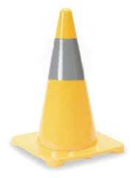

Blast Cones
Blast cones demarcate blasting areas (explosives)
Don’t go through, move or tamper with, unless you have permission from the Shotfirer
Obtain permission from the Shotfirer/Drill & Blast Supervisor/Driller (on drill pattern) before accessing these areas
If you need to pass through any cones in other parts of the site, call up and ask permission from the relevant Supervisor
Blasting Pattern
Drill Pattern
Notes:
Environmental hazards include - Hydrocarbon contaminated products e.g. rags, filters, containers, Tailings spills, Fauna Environmental hazards include - Hydrocarbon spills, Disposal of hydrocarbon contaminated products e.g. rags, filters, containers, Tailings spills, Fauna deaths on mine roads and tailings dams, Leaks and spills from pipelines, Damage to undisturbed areas, Interference with re-vegetation areas, Dust, Chemical usage (toxicity), Chemical spills (seepage), Rubbish, Fire
deaths on mine roads and tailings dams, Leaks and spills from pipelines, Damage to undisturbed areas, Interference with re-vegetation areas, Dust, Chemical usage (toxicity), Chemical spills (seepage), Rubbish, Fire

Slide 21

Caring for the Environment
Caring for the environment is a shared responsibility between:
Big Yellow
our clients
all contractors
ourselves
What are Environmental Hazards?

Slide 22
Aboriginal Heritage Areas
  The Aboriginal People have rights and interests according to tradition and customs and heritage areas have cultural significance
  Heritage sites are protected by the Aboriginal Heritage Act (1972) and penalties exist for anyone who disturbs these sites
  Big Yellow acknowledges the diversity of Aboriginal cultural heritage and will at all times show respect for all sites of significance to the Aboriginal People.

Slide 23
Environmental - Hydrocarbons
When we see a hydrocarbon spill, we:
Control
Contain
Clean Up
Then we report the spill
Yellow wheelie bins hold materials
for dealing with spills
Notes:
Hydrocarbons are a major environmental hazards – this includes oils, grease, fuel,

Slide 24
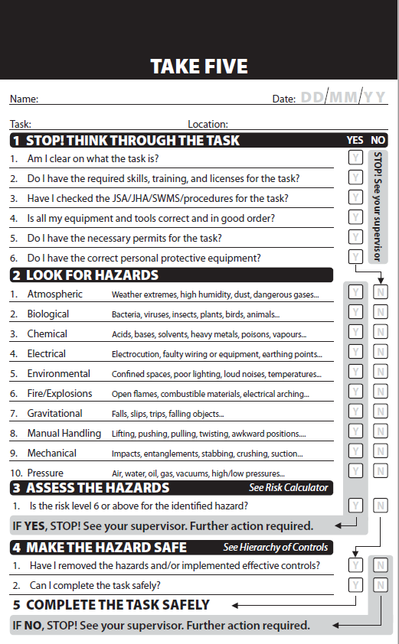
Take 5 Assessment
Complete a Take 5 Assessment before starting any task.
If you find any task for which you aren’t capable or qualified, or don’t understand the job, you must consult your Supervisor.

Slide 25
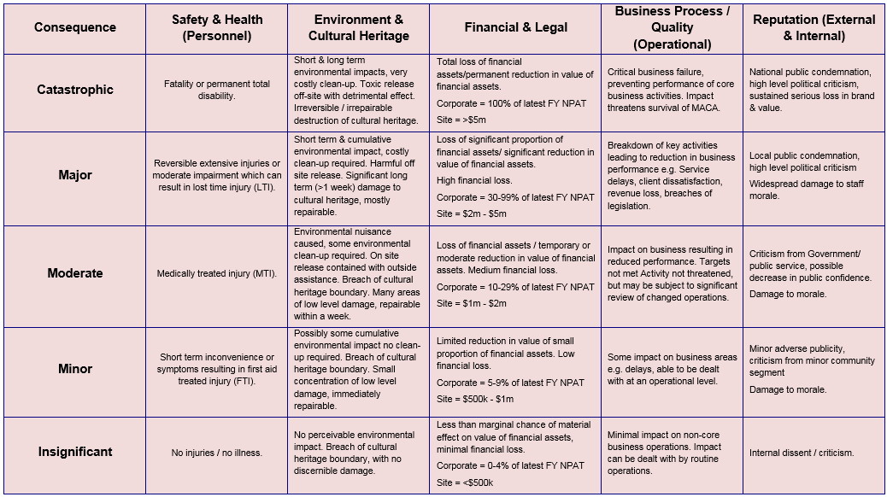
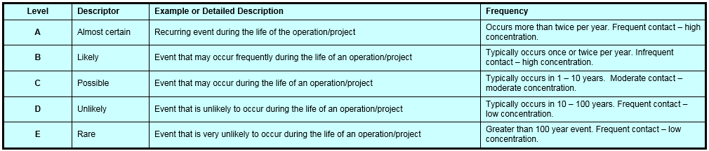
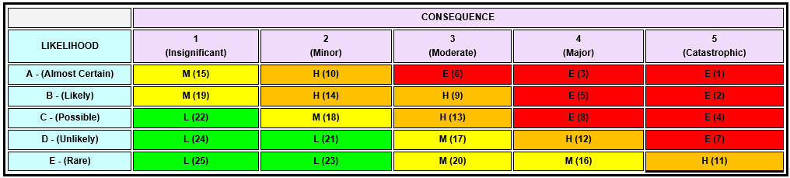
Assessing the Risk of Hazards
Risk Assessment – shows the Likelihood (possibility) & Consequence (outcome) of incidents occurring

Slide 26
Why is it so important to Identify Hazards and Risks
Because it makes us:
Stop! for a moment
Think about the task and your work area as whole
Identify hazards - Ask - is there anything about this task or work area that could hurt me or others?
Eliminate / control hazards so we can work safely (Prevent injury – go home safe).

Slide 27


Respond to the Risk
When hazards are identified, a
combination of controls can be used
Eliminating a hazard is always the
best option.
The Hierarchy of Controls are:
Elimination
Substitution
Isolation
Engineering
Administrative & SOPs
Personal protective equipment (PPE)
Notes:
Explain why elimination is the best option and PPE is the least effective control?
Get Inductee to give examples of each Hierarchy of Control

Slide 28
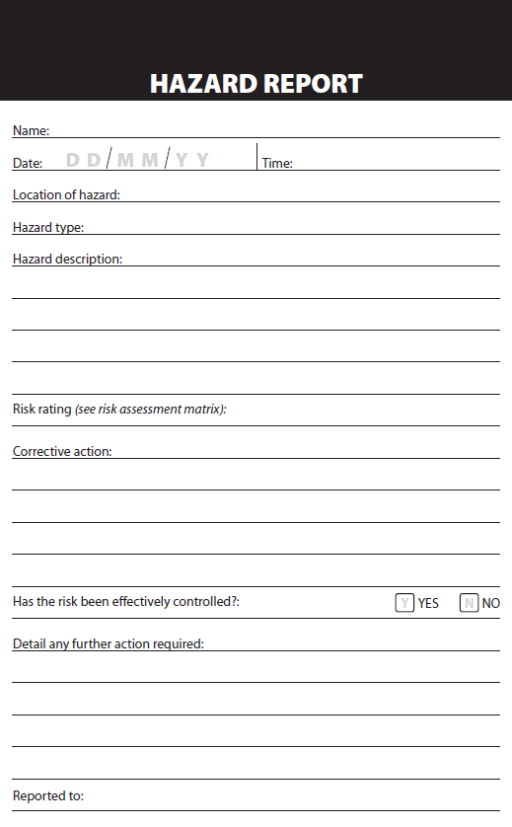
Hazard Observations
Report any hazards you find on a HAZOB and hand to your Supervisor
It is logged into the Hazard Register whether fixed out or not.
Site management reviews and adds other actions if required.
Once actions have been completed it is closed out.

Slide 29
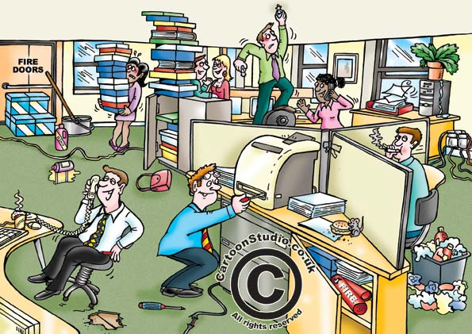
Hazard Observation Activity

Slide 30


Basic Fire
Class A - Ordinary Combustibles
Class B - Flammable Liquids
Wood
Paper
Clothing
Carpet
Material
Leather
Plastic
Vinyl
Rubber
Cardboard
Petrol (Gasoline)
Diesel
Kerosene
Alcohol
Turpentine
Grease
Oil
Paint
Lacquer
Wax
Notes:
Note - there is a different picture for each class of fire

Slide 31


Basic Fire
Class C
Flammable Gases
Class D
Combustible Metals
Acetylene
Butane
Ethylene
Hydrogen
Combustible metals in solid, dust and powdered forms including:
Liquefied Petroleum
Gas (LPG)
Methane
Propane
Aluminium
Lithium
Magnesium
Metal Swarfs
Titanium
Metal Filings

Slide 32

Basic Fire
Class E - Electrical Fires
Fires which involve some form of electrical energy.
If you isolate / disconnect the power to this type of fire, it becomes one of the four earlier types of fire and should be treated accordingly

Slide 33
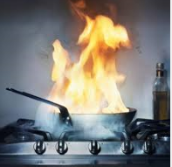

Basic Fire
Fires involving cooking oil, grease or fat.

Slide 34
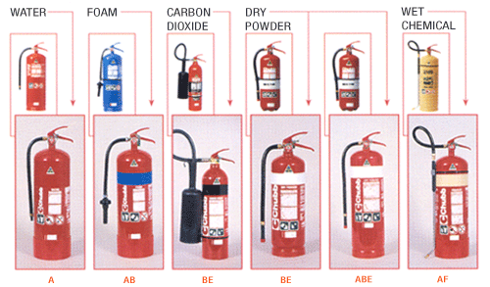
Extinguisher Colours

Slide 35
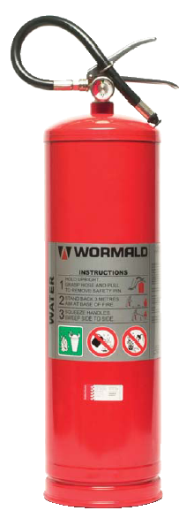
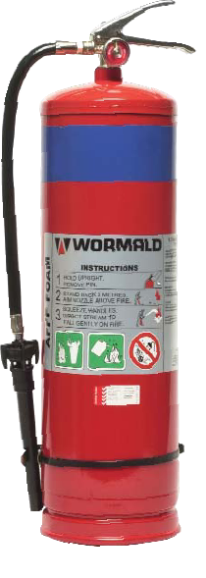
Portable Fire Extinguishers
9.1 Lt. FOAM
Extinguisher –
Solution of AFFF Foam & Water
Discharge Time: 50sec
Effective Range: 4.5m
Suitable for:
Class A & B Fires
9.1 Lt. WATER Extinguisher -
Discharge Time: 80sec
Effective Range: 6m
Suitable for: Class A Fires
Notes:
Water fire extinguishers operate by discharging a stream of water from the nozzle onto the fire. The
water reduces the temperature (cooling) of the burning material below its ignition point, thus extinguishing the fire.
Foam extinguisher contains AFFF foam concentrate and water. The foam forms a blanket over the surface of a burning liquid, (smothering) cutting off the fire’s air supply. The foam blanket reduces the release of flammable vapours, preventing any re-ignition.

Slide 36
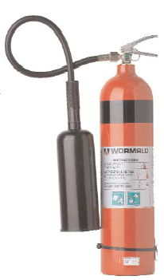
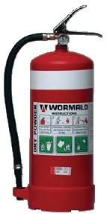
Portable Fire Extinguishers
9.0 Kg Dry Powder
Extinguisher -
Discharge Time: 26sec
Effective Range: 5m
*ABE suitable for:
Class A B C & E fires
(*used at BY)
BE suitable for:
Class B C E & F fires
5.0 Kg CO₂
Extinguisher -
Discharge Time: 29sec
Effective Range:
1-2m
Suitable for:
Class E fires
Notes:
CO2 deplete oxygen from the air, so you should never be in confined or closed spaces.
Dry Chemical Powder (DCP) is the most effective extinguisher used at Big Yellow

Slide 37
Portable Fire Extinguishers
Advantages
Quick to action
Easy to carry
One person operation
Generally located close to the hazard
Disadvantages
Don’t last long
Don’t reach very far
Not all the same
Can be unreliable

Slide 38
Fire Extinguishers
What could happen if you use the Wrong Extinguisher?
?

Slide 39
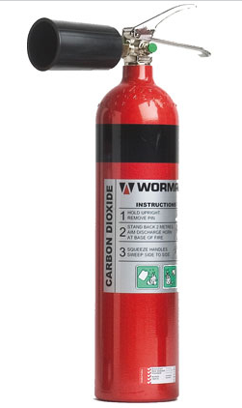
CO2
Things to Remember When Using a CO₂
Extinguisher
Can cause cold burns if sprayed on skin
WILL deplete the oxygen supply in the room, so always make sure you have a clear escape route

Slide 40
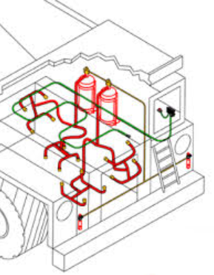
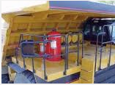
Fire Suppression Systems
Only our PC1250 digger and 777E trucks are fitted with fire suppression systems
Ancillary equipment operators need to double check all fire extinguishers on their gear
Why do we have it?
What parts of the machine will it cover?
Why is it foam?
Notes:
Why do we have it? --- give the operator the time to evacuate the machine
What parts of the machine will it cover? --- engine bay
Why is it foam? --- foam is the most effective extinguishing medium for diesel/oils/etc. which is what would be catching on fire in the engine bay

Slide 41
Before Fighting a Fire
What things should you consider?
Notes:
Size of the fire
Your escape route
Wind direction
Hazards
Do you have the correct extinguishing agent?
Do you know what you are doing?
Is there someone available for backup?

Slide 42
Fire Prevention
What things can help towards fire prevention?
Notes:
Work safely
Working within the regulations
Good housekeeping
Obtaining a hot work permit
No fires on days of high fire danger
Don’t overload power points
Smokers to correctly dispose of cigarette butts
Install and regularly test smoke detectors

Slide 43
“If there is a fire”
Sound The Alarm
Raise the alarm to warn others
Evacuate the Building
Remove yourself from danger and move to the emergency evacuation point
Fight the Fire if Trained To Do So and if Safe to Do So
Attempt to extinguish the fire
Fires Start Small and Quickly Become Large Ones
Don’t try to be a hero

Slide 44
Emergencies on Site
Call “Emergency, Emergency, Emergency” over 2-way
Wait for a response from the Supervisor, Project Manager or ERT Officer
Give your name (but no names of anyone involved)
Provide the exact location
The type of emergency
If anyone is injured (you can provide assistance once you’ve passed on all the information - if you are trained and it is safe to do so)
Remain calm and wait for instructions

Slide 45
Re-acting to Emergency Calls
If you are driving / operating on site,
what should you do when an emergency is called?
Notes:
Pull over to the left hand side of the road
Activate Park Brake
Activate hazard lights
Maintain Radio Silence until “all clear” is given to resume operations

Slide 46
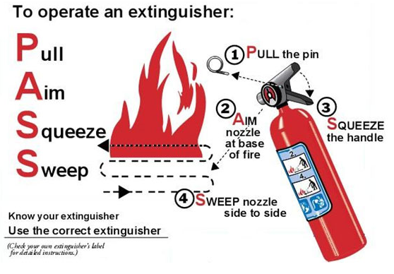
To Operate an Extinguisher

Slide 47
PPE
Personal Protective Equipment
To present Big Yellow well, be sure that your:
Uniforms are free from rips and tears
Your shirt sleeves are rolled down
Shirts tucked into trousers / jeans
Notes:
Uniforms should be free from rips and tears and laundered to remove chemical contaminants.
Clothing should be of the correct size to cover the body without impeding movement.
High visibility reflective vests must be worn such that the reflective tape is visible from both the front and the back.
Shirt sleeves must not be rolled up
Shirts should be tucked into trousers / jeans.

Slide 48
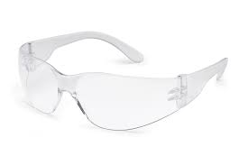
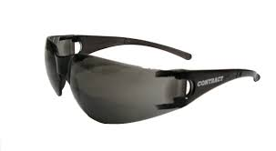

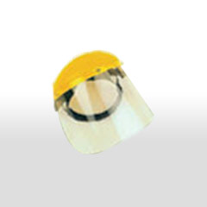

PPE – Safety Glasses
Notes:
Safety glasses should cover the eye area sufficiently.
If personnel have their own safety glasses, they can be worn on site as long as they meet Australian Standard 1336
Safety glasses must be worn outside of airconditioned areas
If your lenses are dirty – wash/clean them; if scratched - replace them. Dealing with fatigue is hard enough let alone when looking through scratched glasses.

Slide 49
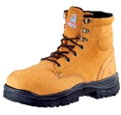
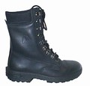
PPE – Safety Boots
Your boots should be laced to the top
Notes:
Boots should be clean and in good condition.
The upper should be intact; the “steel toe” should not be exposed.
The sole of the boot should be intact, attached to the upper and have sufficient tread to prevent slipping of smooth surfaces. Check for damage from chemicals.
Laces should be of sufficient length to enable to boot to be completely laced to the top of the upper.
Eyelets and hooks should be firmly in place and attached.
Boots are ordered in mens sizes

Slide 50
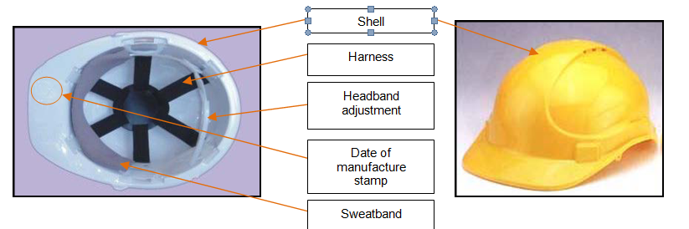
PPE – Hard Hats
What are some of the things you should do to look after your hard hat??
Can you wear other headwear under your hardhat?
Notes:
Inspect for defects
Write your name inside
Write the date inside
Don’t put stickers on the outside
Don’t leave loose in any vehicles (could become a missile)
If involved in severe impact, replace immediately
Caps, hats, beanies and other headwear are not to be worn under helmets.
Inspect for defects
Write your name inside
Write the date inside
Don’t put stickers on the outside
Don’t leave loose in any vehicles (could become a missile)
If involved in severe impact, replace immediately
Caps, hats, beanies and other headwear are not to be worn under helmets.

Slide 51
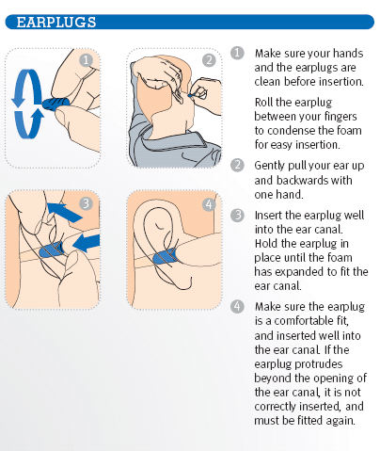
PPE – Hearing Protection
Ear plugs correctly fitted do not extend beyond the tragus of the ear.
When viewing the person front on – the ear plugs will not visible.
Notes:
Ear plugs are an environmental hazard and should be put in rubbish bins not thrown on the ground

Slide 52
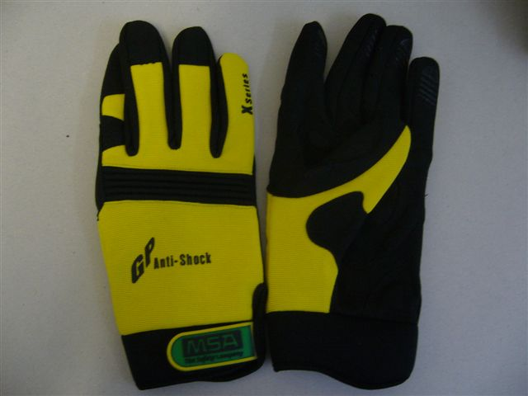
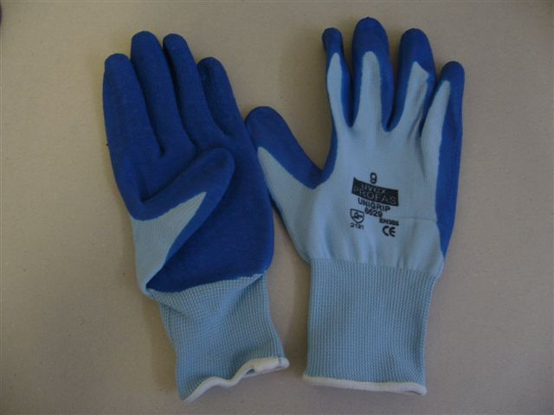

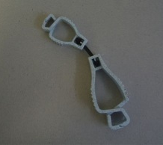
PPE - Gloves
Personnel must use gloves for all manual handling tasks
Everyone is issued with appropriate gloves and a glove clip
Notes:
Gloves should be intact, check for rips, cuts and burns. Check the stitching to ensure glove integrity.

Slide 53
PPE – Dust Masks
Big Yellow can supply both P1 and P2 half face dust masks for respiratory protection
Notes:
Class P1 half face dust masks are intended for use against mechanically generated particulates such as asbestos and silica.
Class P2 half face dust masks are intended for use against both mechanically and thermally generated particulates such as metal fumes.
Obtaining the correct fit for respiratory protection is essential; an ill-fitting mask is not effective and places the person at risk.
Fascial hair reduces the efficiency of masks.

Slide 54
This is the conclusion of this induction.
Firstly, welcome to Big Yellow and may we encourage you to be proactive in your work and ask you to ensure you think and work at health and safety parts of your role that ensures you look after yourselves and your work colleagues.

